Slide 1
Covert Channels:
Hiding Data In Plain Sight
Capt Daniel Fitzgerald
13 JUN 2020

Slide 2
Evaluating Covert Channels
Categorize based on patterns
A Pattern-based Survey and Categorization of Network Covert Channel Techniques by Steffen Wendzel, Sebastian Zander, Bernhard Fechner, Christian Herdin [Wendzel 2014]
https://arxiv.org/pdf/1406.2901.pdf
Author’s addresses: S. Wendzel, Fraunhofer Institute for Communication, Information Processing and Ergonomics FKIE, Bonn, Germany; S. Zander, Centre for Advanced Internet Architectures, Swinburne University of Technology, Melbourne, Australia; B. Fechner, University of Augsburg, Department of Systems and Networking, Augsburg, Germany; C. Herdin, University of Rostock, Department of Computer Science, Rostock, Germany Permission to make digital or hard copies of part or all of this work for personal or classroom use is granted without fee provided that copies are not made or distributed for profit or commercial advantage and that copies show this notice on the first page or initial screen of a display along with the full citation. Copyrights for components of this work owned by others than ACM must be honored. Abstracting with credit is permitted. To copy otherwise, to republish, to post on servers, to redistribute to lists, or to use any component of this work in other works requires prior specific permission and/or a fee. Permissions may be requested from Publications Dept., ACM, Inc., 2 Penn Plaza, Suite 701, New York, NY 10121-0701 USA, fax +1 (212) 869-0481, or permissions@acm.org. c 2014 ACM 0360-0300/2014/-ART1 $15.00 DOI:http://dx.doi.org/10.1145/0000000.0000000

Slide 3
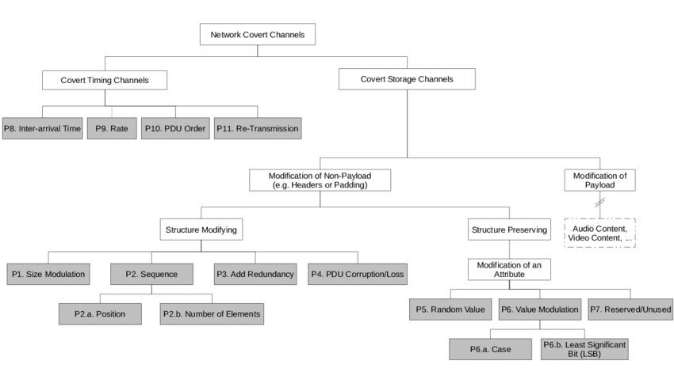
Evaluating Covert Channels
[Wendzel 2014]

Slide 4
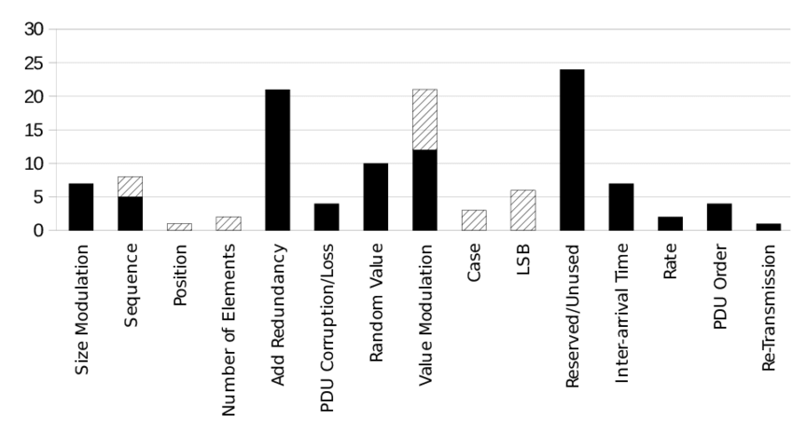
Evaluating Covert Channels
109 covert channels analyzed fit into 11 different patterns
69.7% can be categorized into only 4 different patterns
[Wendzel 2014]
Notes:
Screenshot from A Pattern-based Survey and Categorization of Network Covert Channel Techniques by Steffen Wendzel
https://arxiv.org/pdf/1406.2901.pdf

Slide 5
Evaluating Covert Channels
P1. Size Modulation Pattern
Illustration: Uses size of a header element or PDU to encode message
Context: Storage -> Modification of Non-Payload -> Structure Modifying
Evidence:
Data block length in LAN frames
Padding field’s size in 802.3 frames
Message length of network packets
Size of IPSec messages
IP fragment sizes

Slide 6
Evaluating Covert Channels
P2. Sequence Pattern
Illustration: Alters the sequence of header/PDU elements to encode message
Context: Storage -> Modification of Non-Payload -> Structure Modifying
Evidence:
Sequence of HTTP header fields
Sequence of DHCP options
Sequence of FTP commands

Slide 7
Evaluating Covert Channels
P2.a. Position Pattern
Illustration: Alters position of a given header/PDU element
Context: Storage -> Non-Payload -> Structure Modifying -> Sequence
Evidence:
Position of IPv4 option in options list
Position of IPv6 extension header in extension header list
P2.b. Number of Elements Pattern
Illustration: The number of header/PDU elements transferred
Context: Storage -> Non-Payload -> Structure Modifying -> Sequence
Evidence:
Number of options placed in an IPv4 packet
Modulate number of fragments created from an original IP packet
Modulate number of options placed in a DHCP packet

Slide 8
Evaluating Covert Channels
P3. Add Redundancy Pattern*
Illustration: Creates new space within a given header element/PDU
Context: Storage -> Non-Payload -> Structure Modifying
Evidence:
Generate packets with IPv4 options
Create new IPv6 destination option
Extend HTTP headers with additional fields
Manipulate pointer and length values for IPv4 record route option
Add random bytes to an encrypted SSH message
Extend SMTP packet headers with additional fields
Hide data in unused bits of the DHCP chaddr field
Encapsulate IP packet with smaller size than specified in Ethernet frame

Slide 9
Evaluating Covert Channels
P4. PDU Corruption/Loss Pattern
Illustration: Generates corrupted PDUs or actively utilize packet loss
Context: Storage -> Non-Payload -> Structure Modifying
Evidence:
Generate corrupted messages in broadcast erasure channels
Transfer corrupted frames in 802.11
MitM adversary between 2 VPN sites drops selected packets exchanged

Slide 10
Evaluating Covert Channels
P5. Random Value Pattern*
Illustration: Embed data in header element containing “random” value
Context: Storage -> Non-Payload -> Structure Preserving -> Modification of an Attribute
Evidence:
IPv4 Identifier field
First sequence number of a TCP connection (ISN)
TCP ISN using a bounce server
DHCP xid field
SSH MAC field

Slide 11
Evaluating Covert Channels
P6. Value Modulation Pattern*
Illustration: Channel selects one of n values a header element can contain
Context: Storage -> Non-Payload -> Structure Preserving -> Modification of an Attribute
Evidence:
Send frame to one of n available addresses in local network
Encode info by n of the possible IP header TTL values
Encode info by n of possible Hop Limit values in IPv6 header
Encode info by sending packet using one of n possible application layer protocols
Encode info in the target IP of ARP messages
Send IPSec packets from one VPN site to specific destination IPs within another VPN site

Slide 12
Evaluating Covert Channels
P6.a. Case Pattern
Illustration: Case-modification of letters in header elements
Context: Storage->Non-Payload->Structure Preserving->Modification of Attribute-> Value Modulation
Evidence:
Case modification in HTTP headers or SMTP/POP3/etc. commands and headers
P6.b. Least Significant Bit (LSB) Pattern
Illustration: Uses LSB of header elements
Context: Storage->Non-Payload->Structure Preserving->Modification of Attribute-> Value Modulation
Evidence:
IPv4 timestamp option by sending at even/odd times
Use LSB of IPv4 TTL or IPv6 Hop Limit or Hop Count field of BACnet protocol

Slide 13
Evaluating Covert Channels
P7. Reserved/Unused Pattern*
Illustration: Encode data into reserved or unused header/PDU element
Context: Storage->Non-Payload->Structure Preserving->Modification of an Attribute
Evidence:
Unused fields in IPv4, e.g. ID field, DF flag, Reserved flag
Unused fields in IPv6 header or extension headers
ICMP echo payload
Unused fields in BACnet header
Place data behind string termination symbol of sname/file DHCP fields
DS field of outbound IPSec connections
ECN field in IPSec connections

Slide 14
Evaluating Covert Channels
P8. Inter-arrival Time Pattern
Illustration: Alters timing intervals between network PDUs (inter-arrival times)
Context: Timing Channels
Evidence:
Timings between LAN frames sent
Response time of HTTP server
Timings between BACnet/IP packets
Introduce artificial delays into inter-arrival times of SSH packets
Record legitimate traffic sequence, partition sequence and replay the inter-arrival times of a particular partition

Slide 15
Evaluating Covert Channels
P9. Rate Pattern (Throughput Pattern)
Illustration: Sender alters data rate of traffic flow from self or 3rd party
Context: Timing Channels
Evidence:
Exhaust performance of a switch to affect the throughput of 3rd party connection
Manipulate serial communication port’s throughput by delaying Clear to Send/Read to Send commands
Directly alter data rate of legitimate channel

Slide 16
Evaluating Covert Channels
P10. PDU Order Pattern
Illustration: Encode data using synthetic PDU order for given number of PDUs flowing between sender and receiver
Context: Timing Channels
Evidence:
Modify order of IPSec Authentication Header (AH) packets
Modify order of IPSec ESP packets
Modify order of TCP packets
Modify order of IPSec packets for inbound/outbound VPN traffic
Sender transfers frames in a way they are send before or after a legitimate user’s frames in CSMA/CD networks

Slide 17
Evaluating Covert Channels
P11. Re-Transmission Pattern
Illustration: Channel re-transmits previously send/received PDUs
Context: Timing Channels
Evidence:
Transfer selected DNS requests once/twice to encode bit per request
Duplicate 802.11 packets
Re-transmit selected TCP segments
Do not ACK received packets in order to force sender to re-transmit

Slide 18
Evaluating Covert Channels
[Wendzel 2014]

Slide 19
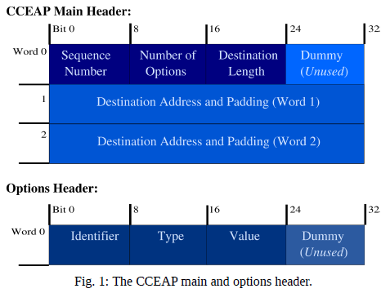
Evaluating Covert Channels
[Wendzel 2014]

Slide 20
Practice Evaluating/Categorizing
CCEAP PCAPs
Previous Practice Problems

Slide 21
Detection
Firewalls – Packet vs Stateful vs Application
Intrusion Detection System – Automate analysis and alert
Intrusion Prevention System – Automate, alert, block
SNORT/NIDS
Moloch – Analysis tool
Endgame???
Security Onion – Blue team security OS
Signatures vs Heuristic vs Patterns

Slide 22
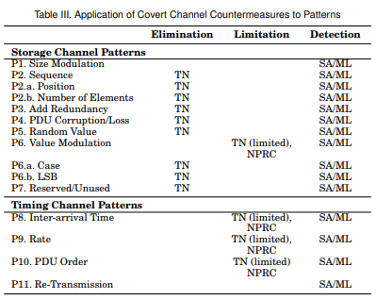
Detection
Detect vs Limit vs Eliminate
Machine Learning? (ML)
Support Vector Machines
Neural Networks
C4.5 Decision Trees
Traffic Normalization (TN)
Replace Unused/Fixed/Derivate
Statistical Approaches (SA)
Anomaly Detection Tools
Web Tap [Borders 2004]
Tunnel Hunter [Dusi 2008]
[Wendzel 2014]

Slide 23
Detection
Dr J video: https://drive.google.com/file/d/16HpL1qxRjlv6YxaC59_Jb3yMlKtvaJni/view?fbclid=IwAR2PlPvzaUYx6Dvmn2X0-ro398YgznFL4QzrdKxUlN7lBlHzx9LdZAWsVys
Recommend watching the entire video
7:35 for Hume’s Induction Problem
47:28 for why AI/ML wont save us (ends at 50:30)

Slide 24
Questions?
Capt Daniel Fitzgerald
fitzgerald.daniel.p@gmail.com

Slide 25
Main References
Covert Channel SANS White Paper [Couture 2010]
https://www.sans.org/reading-room/whitepapers/detection/covert-channels-33413
Pattern-based Survey and Categorization of Network Covert Channels [Wendzel 2014]
https://arxiv.org/pdf/1406.2901.pdf
Google

